Slide 1

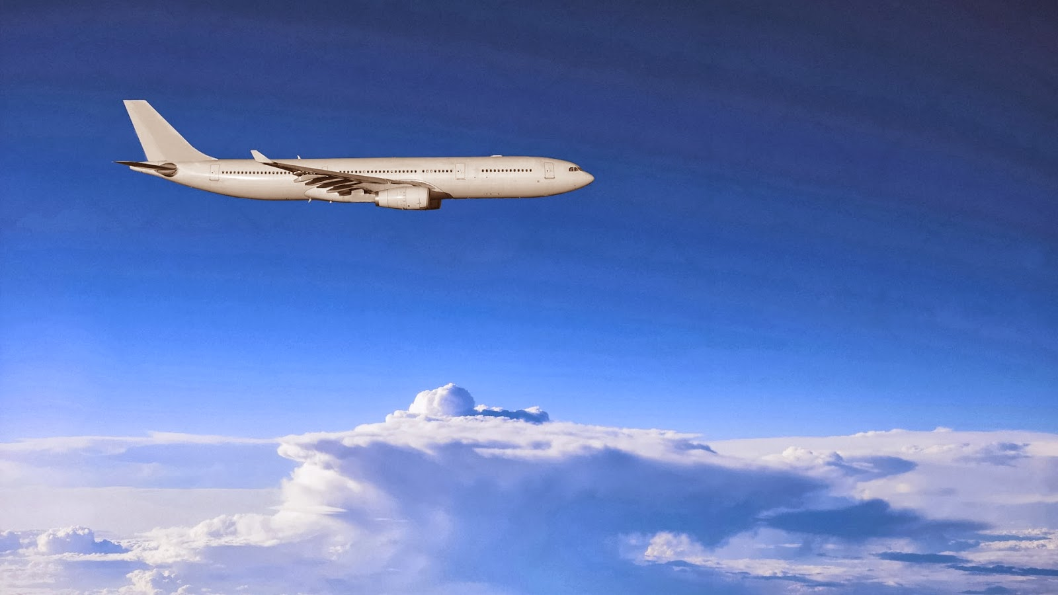

Flight Price Prediction
Hinal Seth
This Photo by Unknown Author is licensed under CC BY

Slide 2
ABSTRACT
Flight ticket prices can be something hard to guess, today we might see a price, check out the price of the same flight tomorrow, it will be a different story. We might have often heard travellers saying that flight ticket prices are so unpredictable.
Anyone who has booked a flight ticket knows how unexpectedly the prices vary. Airlines use using sophisticated quasi-academic tactics which they call "revenue management" or "yield management". The cheapest available ticket on a given flight gets more and less expensive over time. This usually happens as an attempt to maximize revenue based on -
Time of purchase patterns (making sure last-minute purchases are expensive)
Keeping the flight as full as they want it (raising prices on a flight which is filling up in order to reduce sales and hold back inventory for those expensive last-minute expensive purchases)

Slide 3
OBJECTIVE
To Scrape the data from website (I have scrapped the data from yatra.com) and then build a machine learning model to predict the price of the flights.

Slide 4
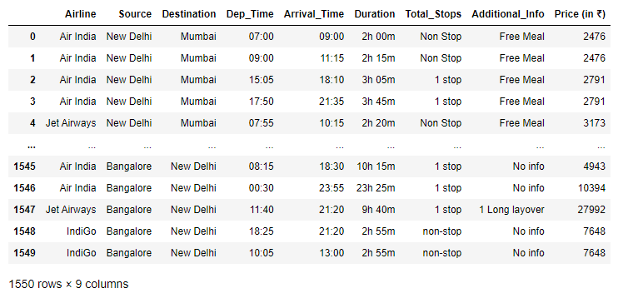
DATA COLLECTION
Data Collection is one of the most important aspect of this project. There are various sources of airfare data on the Web, which I could use to train our models. A multitude of consumer travel sites supply fare information for multiple routes, times, and airlines.
I tried various sources ranging from many APIs to scraping consumer travel websites like yatra.com .

Slide 5
DATA CLEANING
There were no missing values in the dataset.
All the features are of object data type, hence no need to check for outliers and skewness.
There are few repetitive tuples but they are in acceptable range.
The target is tightly distributed.

Slide 6
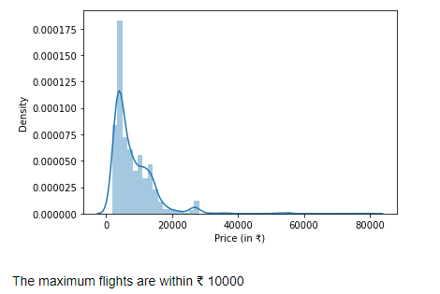
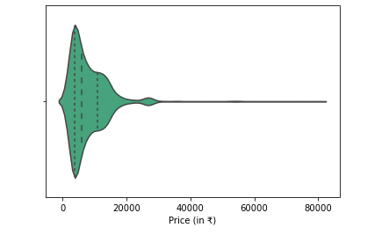
Exploratory Data Analysis
Distribution Plot Violin Plot

Slide 7
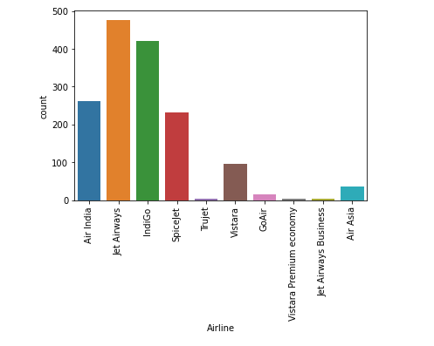
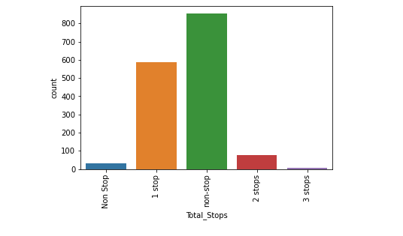
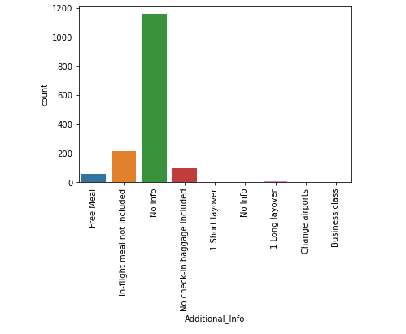
Count Plot
Airlines
Total Stops
Additional Info

Slide 8
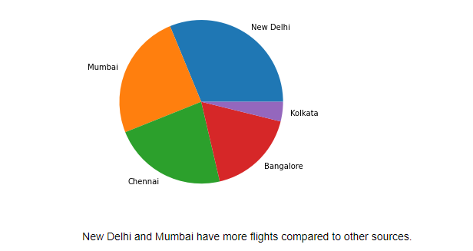
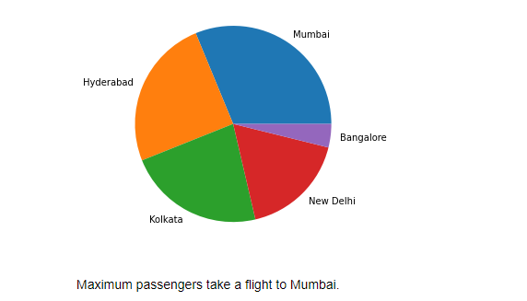
Pie Plot

Slide 9
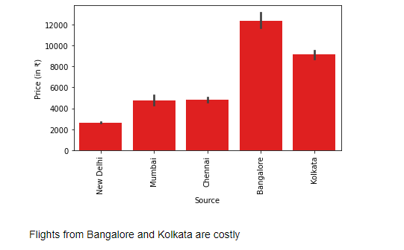
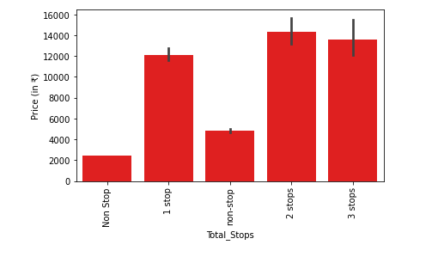
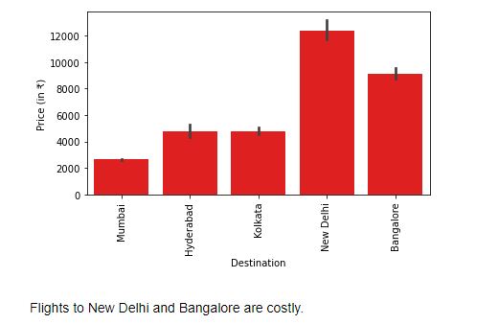
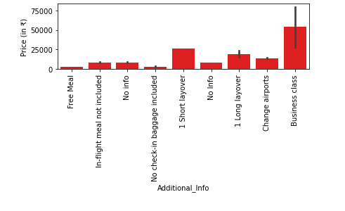
Bar Plot

Slide 10
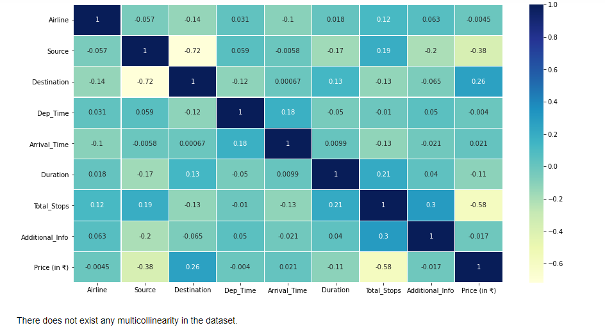
Heat Map

Slide 11
MODEL BUILDING
I have applied 7 algorithms here :
Ridge Regression (44.27% accuracy)
Elastic Net (44.27% accuracy)
K Neighbors Regression (60.29% accuracy)
SGD Regression (44.60% accuracy)
Decision Tree Regression (76.46% accuracy)
Random Forest Regression (81.95% accuracy)
Gradient Boosting Regression (75.95% accuracy)

Slide 12
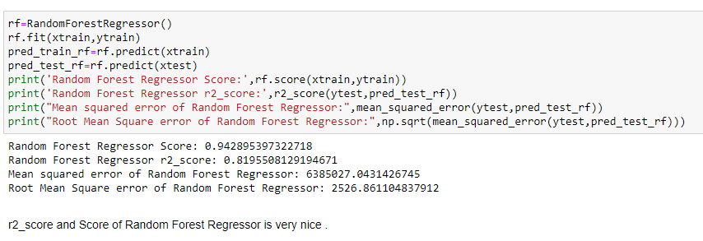
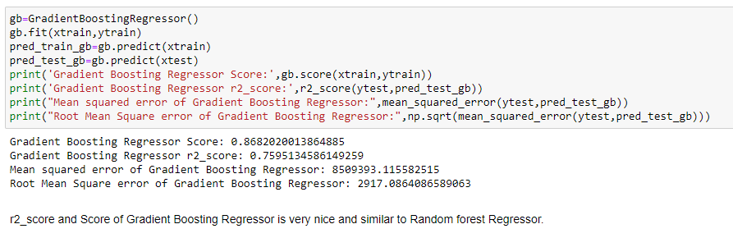

Slide 13
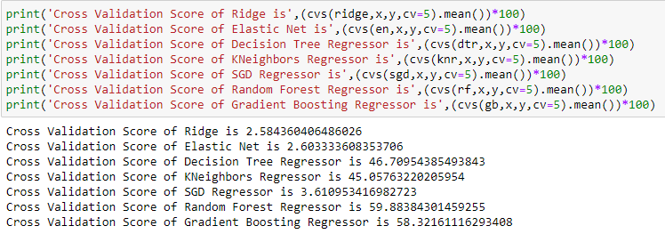
CROSS VALIDATION SCORE
The least difference between r2_score and cross validation score is for Random Forest Regressor, hence we will use that model.

Slide 14
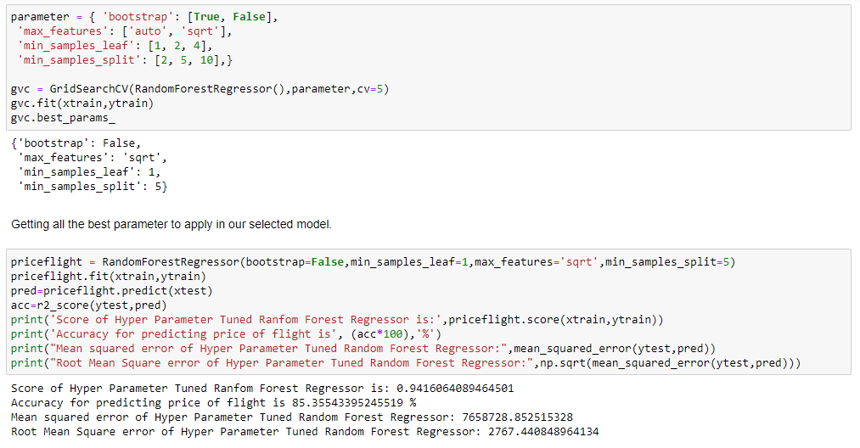
HYPER PARAMETER TUNING

Slide 15
CONCLUSION
The Jet Airway Airlines are more costly than others whereas SpiceJet and IndiGo are quite affordable. Flights from metro cities are more in number and hence few are in budget and few are way too expensive. The expensive flights usually come with layover(long/short), free meal and some other additional facilities as well.
The trend of flight prices vary over various months and across the holiday. There are two groups of airlines: the economic group and the luxurious group. Spicejet, AirAsia, IndiGo, Go Air are in the economical class, whereas Jet Airways and Air India in the other. Vistara has a more spread out trend.

